Slide 1

CORPORATE CLASSIFIEDS
Your personal Online Exchange

Slide 2
OUR TEAM
Jishnu Gopalan K P S D Swetha Reddy
(2143970) (2141429)
Adesh Shriram Oak
(2144028)
Sadurla Bhanu Prasad Divya Sri Sankurathri
(2143987) (2143999)

Slide 3
Project Overview
An organization has to create an Classifieds App for its employees to allow posting of ads on a particular product that the employees can buy and sell within the employee community. The employee who posts an offer in Classifieds Application is a seller and an employee who shows interest is a consumer. Though the real selling doesn’t happen over the app, an engagement between the seller and the consumer is created, by liking/commenting to the offer.

Slide 4
Technology Used
Backend
Spring boot
Front end
Angular
Database
Mysql

Slide 5
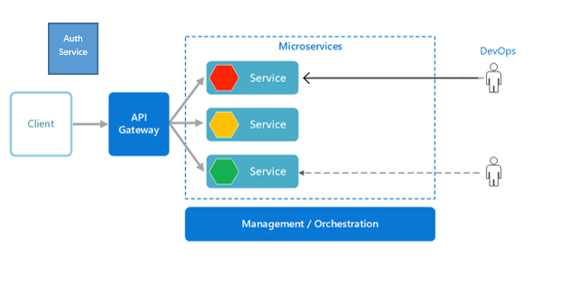
System Architecture Diagram

Slide 6
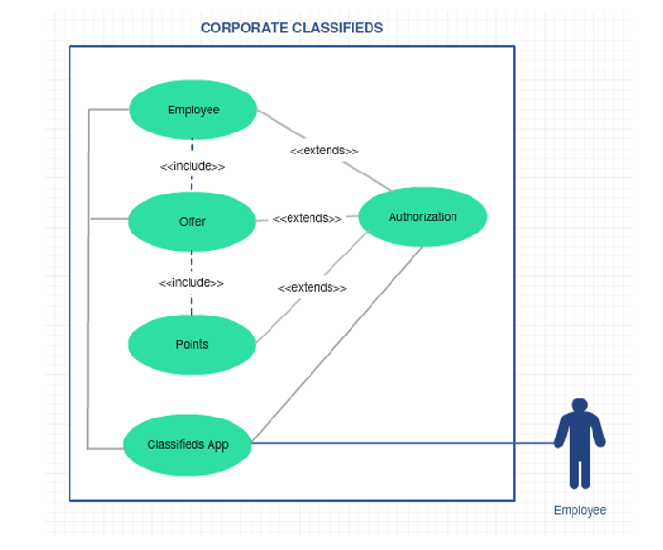
Use Case Diagram

Slide 7
CORPORATE CLASSIFIEDS IN A SHELL
Offer microservice
Classifieds Portal (medium)
Employee microservice
USER
Authentication microservice
Points microservice

Slide 8
REQUIREMENT ANALYSIS

Slide 9
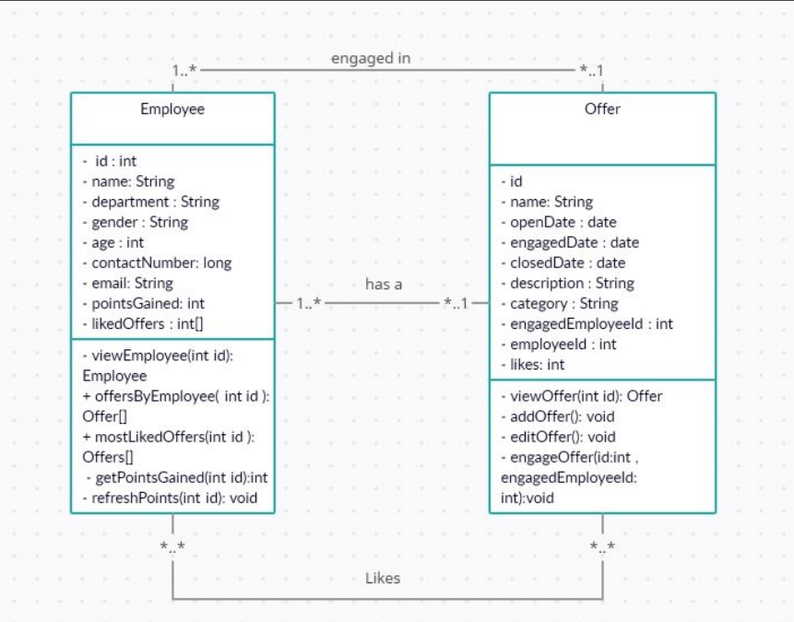
CLASS DIAGRAM

Slide 10
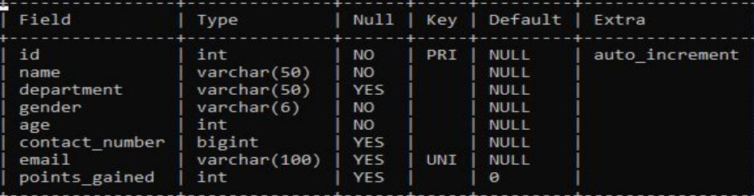
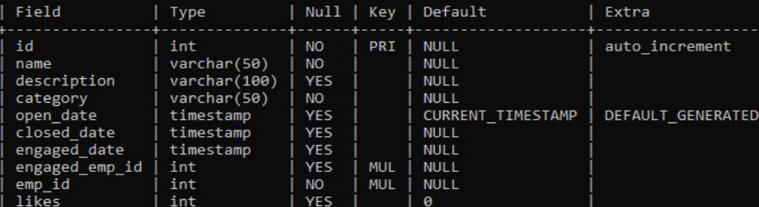
SQL TABLES
EMPLOYEE TABLE
OFFER TABLE

Slide 11
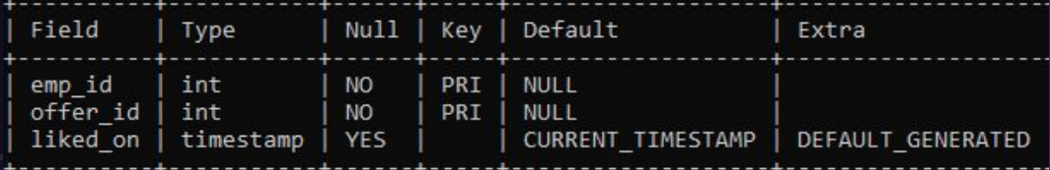
SQL TABLES (CONTINUED)
LIKED BY TABLE (To describe many to many relationship between offers and employee)

Slide 12
DEVELOPMENT & DESIGNING

Slide 13
MICROSERVICES
╸ Auth microservice - to handle authentication of the employee
╸ Employee microservice - to handle employee related services
╸ Offer microservice - to handle offer related services
╸ Points microservice - to refresh points gained by the employee

Slide 14
AUTH MICROSERVICE

Slide 15
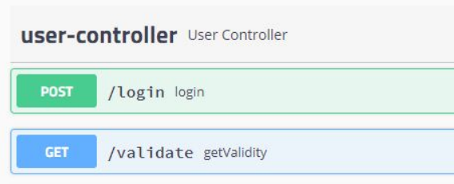
REST ENDPOINTS
╸ /login - to log in the employee and generate jwt token
╸ /validate - to validate the jwt token
A look at swagger.html for auth microservice

Slide 16
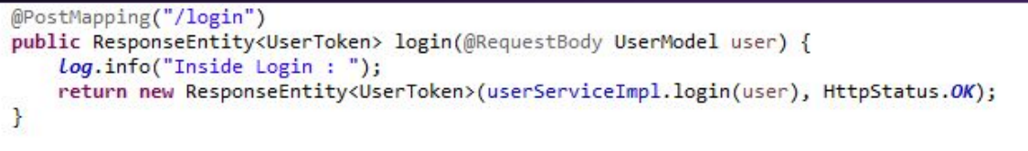
Rest Controller (a gist)
One of the Post mappings of the rest controller
(to login the user)
Rest controller calls the UserServiceImpl.java where all the necessary details are implemented

Slide 17
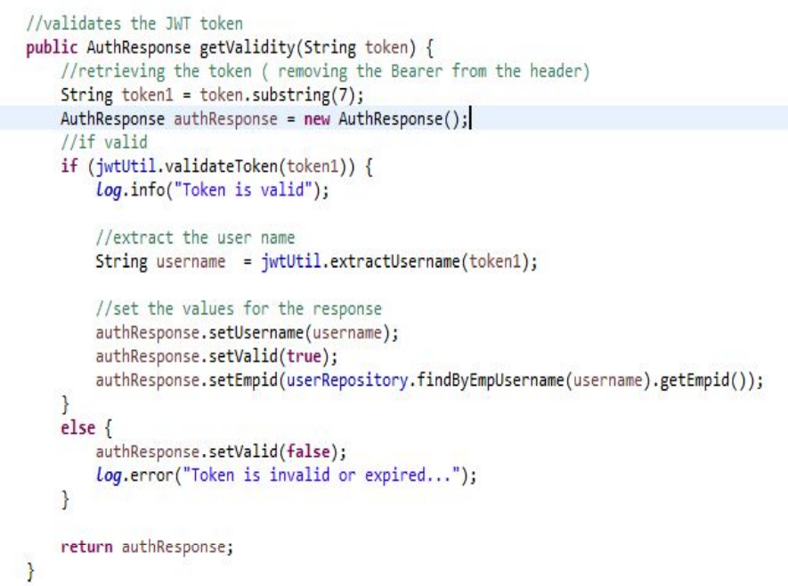
AUTH SERVICE

Slide 18
EXCEPTION HANDLING
╸ Rest Exception handler - to handle all the exceptions that occurs in the microservice with proper status code
╸ UnauthorizedException - thrown when the user is invalid.

Slide 19
EMPLOYEE MICROSERVICE

Slide 20
REST ENDPOINTS
╸ /employee/viewProfile/{id} - to view employee details by id parameter
╸ /employee/viewEmployeeOffers/{id} - to view all the offers posted by the employee through id parameter
╸ /employee/viewMostLiked/{id} - to view top 3 most liked offers of the employee by id parameter

Slide 21
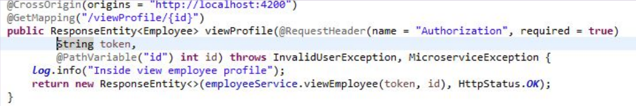
Rest Controller (a gist)
One of the Get mappings of the rest controller
(to view the profile of the user)
Rest controller calls the employeeServiceImpl.java where all the
necessary details are implemented

Slide 22
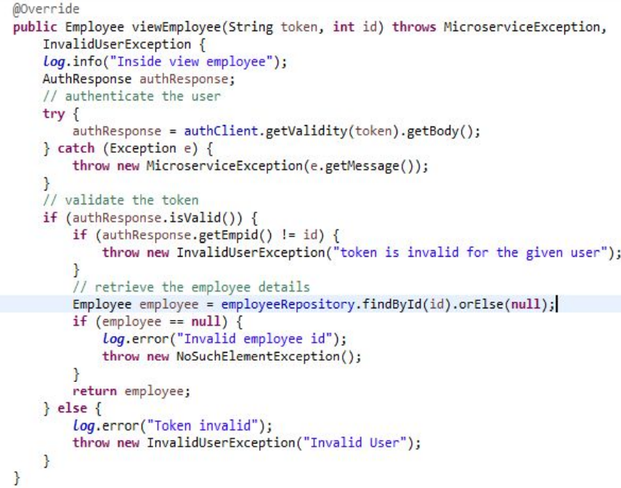
EMPLOYEE SERVICE

Slide 23
EXCEPTION HANDLING
╸ Employee Exception handler - to handle all the exceptions that occurs in the microservice with proper status code
╸ InvalidUserException - thrown when the user is unauthorized
╸ MicroserviceException - thrown when there is an error in the communicated microservice.

Slide 24
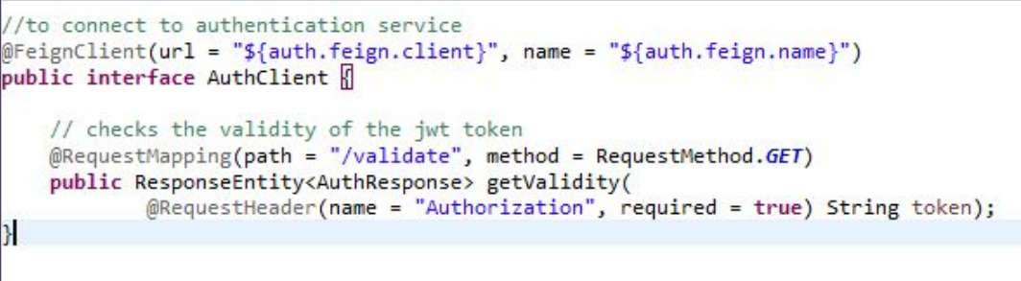
FEIGN CLIENTS
╸ Auth client - to communicate with the authentication microservice
╸ Offer client - to communicate with the offer microservice
Interface of AuthClient

Slide 25
OFFER MICROSERVICE

Slide 26
REST ENDPOINTS
╸ /offer/addOffer - to post a new offer
╸ /offer/editOffer - to edit an existing offer
╸ /offer/engageOffer - to engage an offer
╸ /offer/getOfferByCategory - to filter offers by category
╸ /offer/getOfferByPostedDate - to filter offers by posted date
╸ /offer/getOfferByTopLikes - to retrieve top 3 most liked offers
╸ /offer/getOfferDetails/{id} - to retrieve offer by id parameter

Slide 27
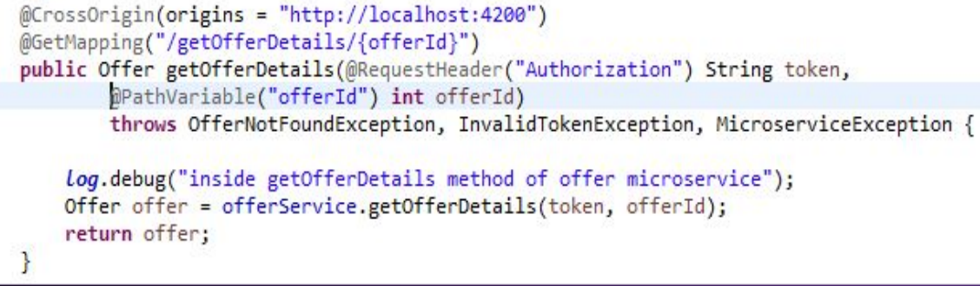
Rest Controller (a gist)
One of the Get mappings of the rest controller (to get the details of an offer by offer id) Rest controller calls the offerService.java where all the necessary details are implemented

Slide 28
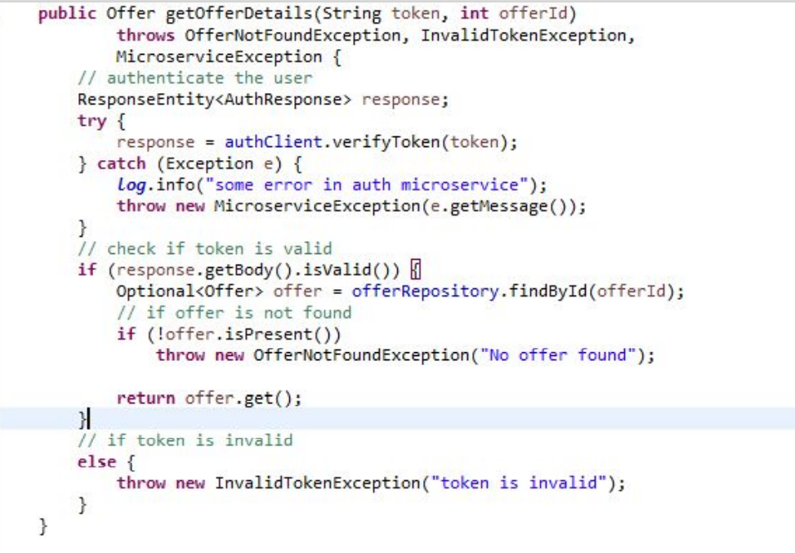
OFFER SERVICE

Slide 29
EXCEPTION HANDLING
╸ Global Exception handler - to handle all the exceptions that occurs in the microservice with proper status code
╸ EmployeeNotFoundException - thrown when no employee is found
╸ ImproperDateException - thrown when improper date is passed
╸ InvalidTokenException - thrown when the jwt token is invalid
╸ MicroserviceException - thrown when the communicated microservice is not working
╸ OfferNotFoundException - thrown when no offers are found

Slide 30
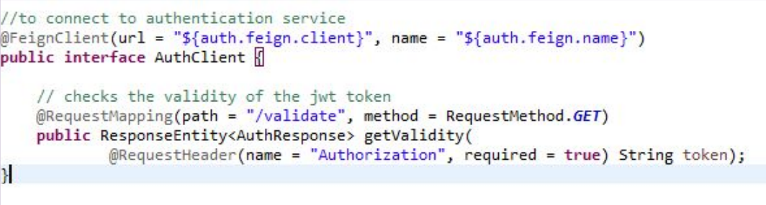
FEIGN CLIENTS
╸ Auth client - to communicate with the authentication microservice
╸ Employee client - to communicate with the employee microservice
Interface of AuthClient

Slide 31
POINTS MICROSERVICE

Slide 32
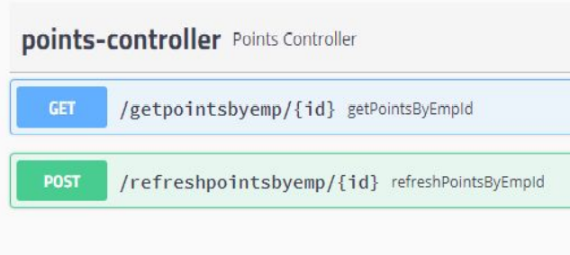
REST ENDPOINTS
╸ /getpointsbyemp/{id} - to get points gained by the employee
╸ /refreshpointsbyemp/{id} - to refresh the points of the employee
A look at swagger (for points controller)

Slide 33
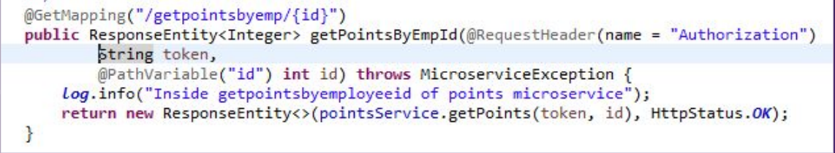
Rest Controller (a gist)
One of the Get mappings of the rest controller (to get the points gained by the employee)
Rest controller calls the pointsServiceImpl.java where all the necessary details are implemented

Slide 34
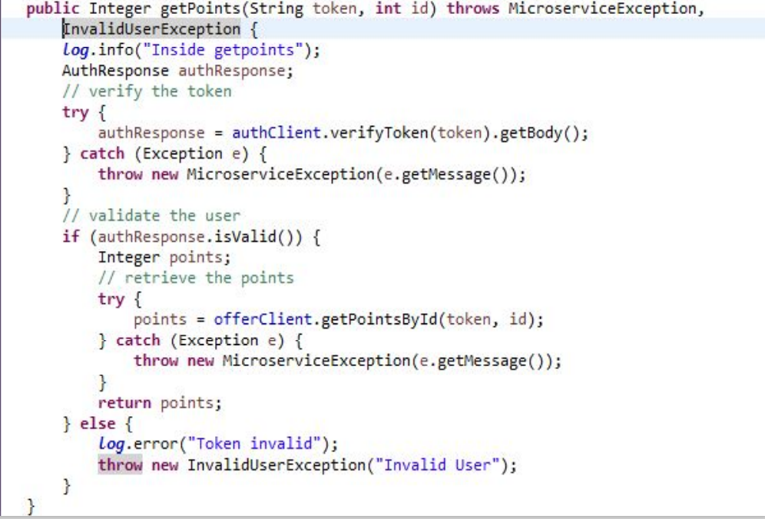
POINTS SERVICE

Slide 35
EXCEPTION HANDLING
╸ InvalidUserException - thrown when the jwt token is invalid
╸ MicroserviceException - thrown when the communicated
microservice is not working
╸ PointsExceptionHandler - to handle all the exceptions thrown by the
rest controller

Slide 36
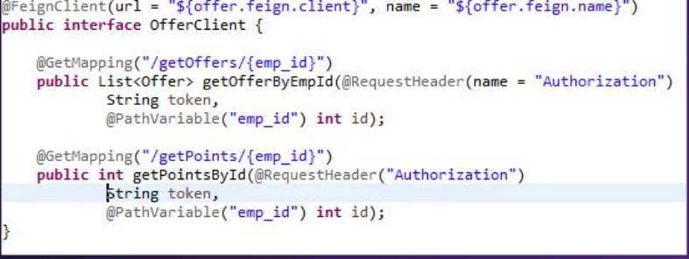
FEIGN CLIENTS
╸ Auth client - to communicate with the authentication microservice
╸ Employee client - to communicate with the employee microservice
╸ Offer client - to communicate with the offer microservice
Interface of Offer Client

Slide 37
TESTING

Slide 38
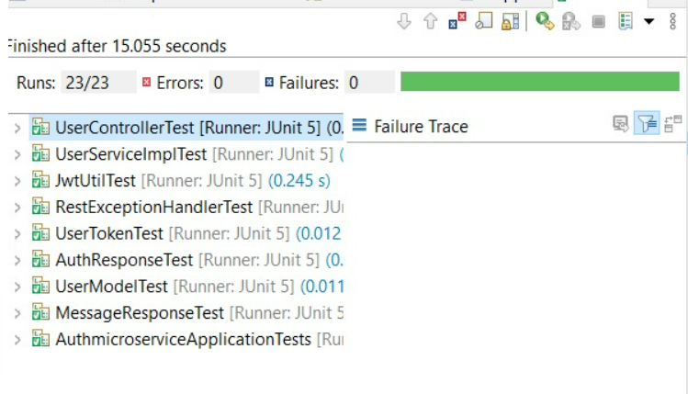
AUTH MICROSERVICE
╸ AuthMicroserviceApplicationTests
╸ UserControllerTest
╸ RestExceptionHandlerTest
╸ JwtUtilTest
╸ ModelTests
╸ UserServiceImplTest
There are 23 test cases and all of them pass successfully

Slide 39
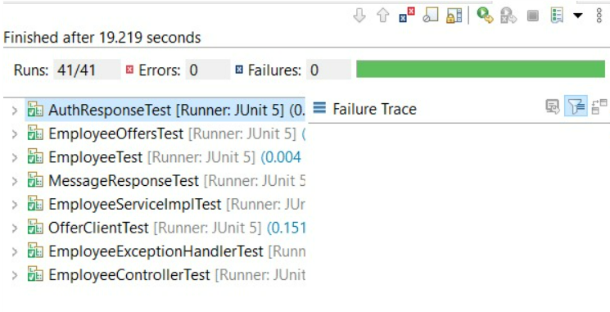
EMPLOYEE MICROSERVICE
╸ EmployeeMicroserviceApplicationTests
╸ OfferClientTest
╸ EmployeeControllerTest
╸ EmployeeExceptionHandlerTest
╸ ModelTests
╸ EmployeeServiceImplTest
There are 41 test cases and all of them pass successfully

Slide 40
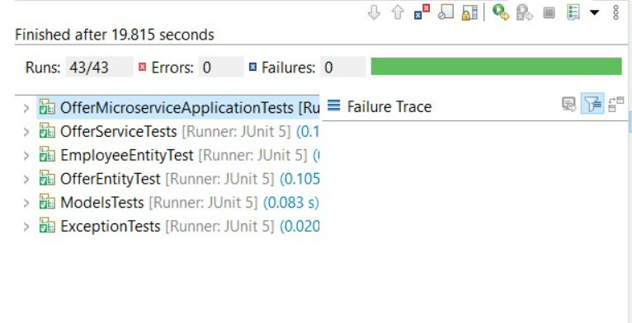
OFFER MICROSERVICE
╸ EmployeeEntityTests
╸ ExceptionTests
╸ OfferEntityTests
╸ OfferServiceTests
╸ ModelTests
There are 43 test cases and all of them pass successfully

Slide 41
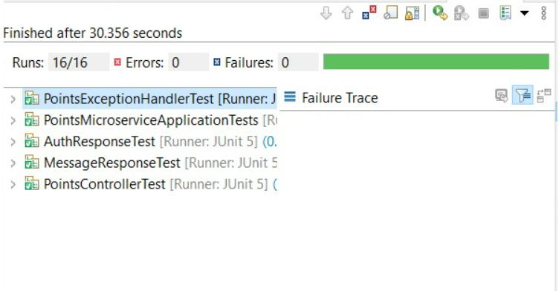
POINTS MICROSERVICE
╸ PointsMicroserviceApplicationTest
╸ PointsControllerTests
╸ PointsExceptionHandlerTests
╸ ModelTests
There are 16 test cases and all of them pass successfully

Slide 42
USER INTERFACE

Slide 43
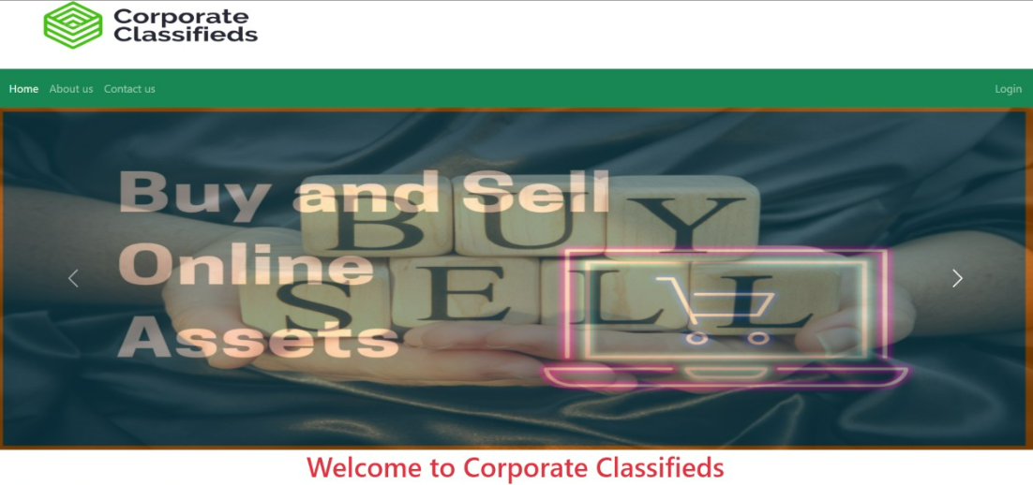
LANDING PAGE

Slide 44
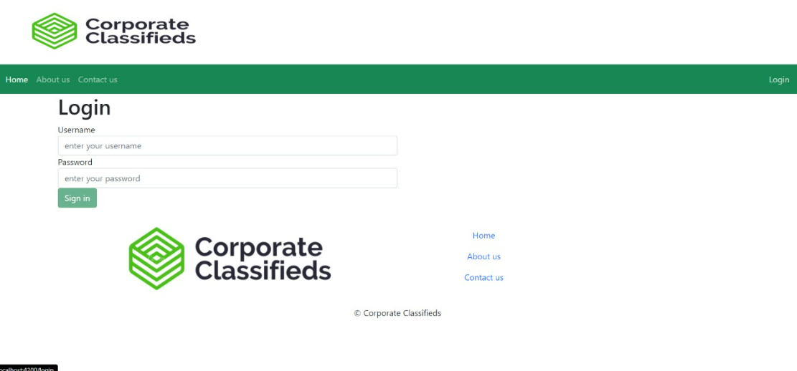
LOGIN PAGE

Slide 45
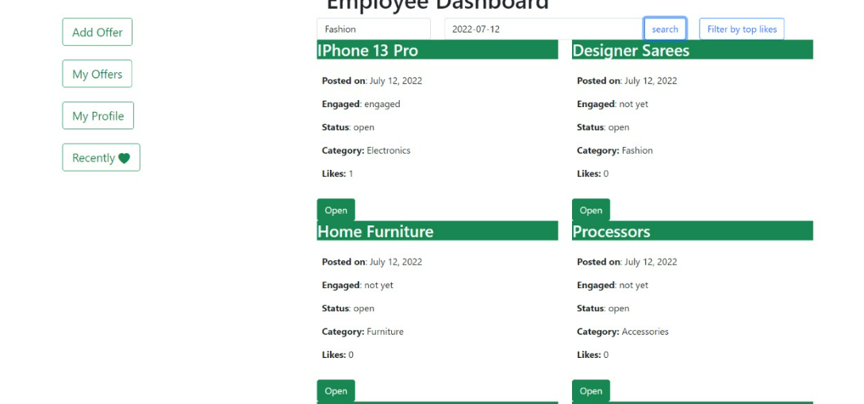
MAIN PAGE

Slide 46
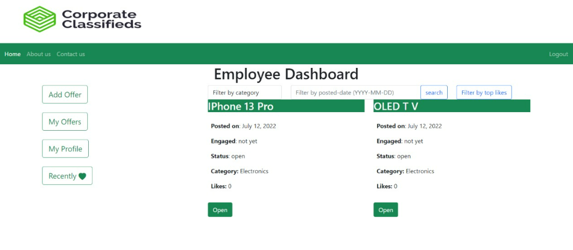
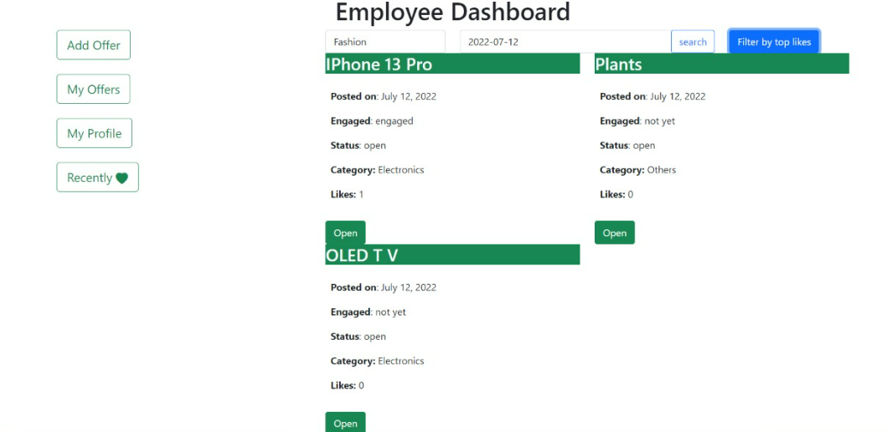
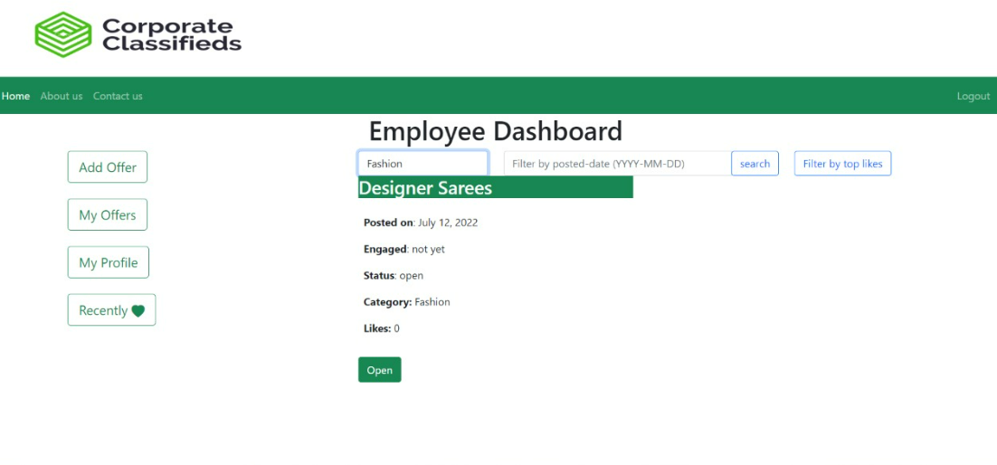

Slide 47
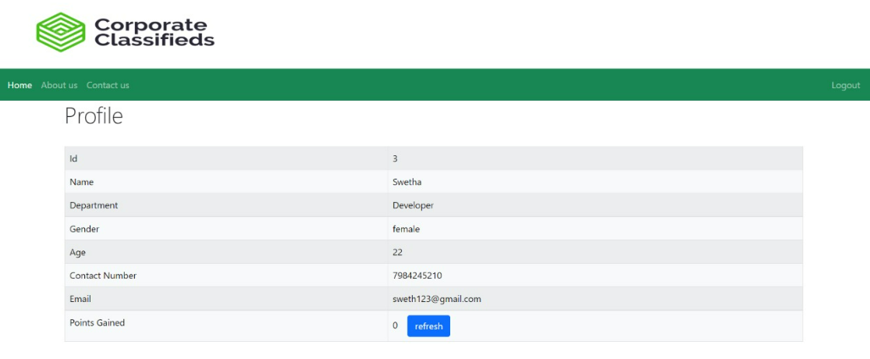
PROFILE PAGE

Slide 48
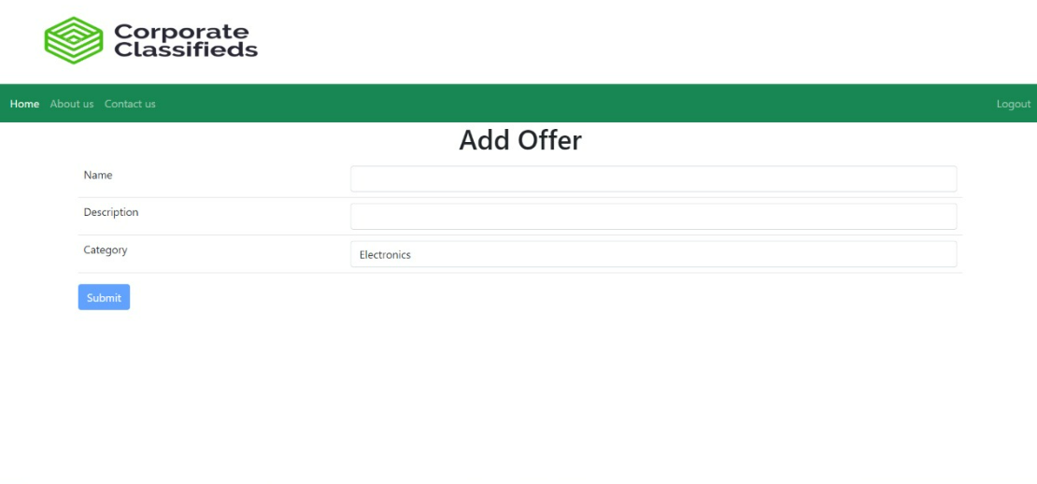
ADD OFFER PAGE

Slide 49
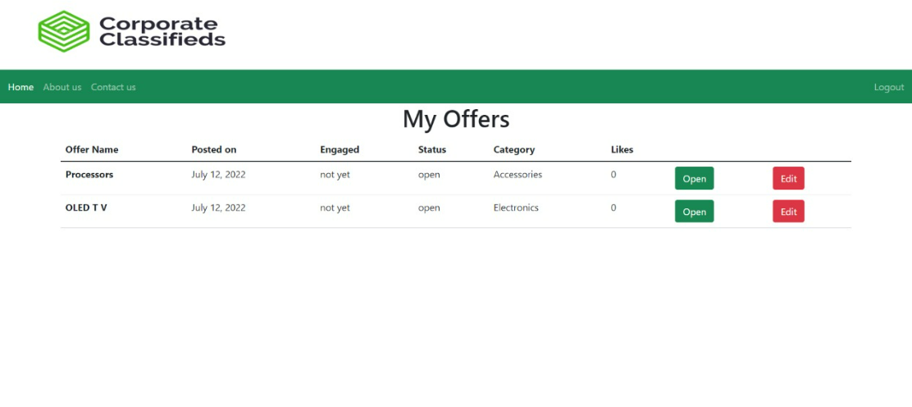
MY OFFERS PAGE

Slide 50
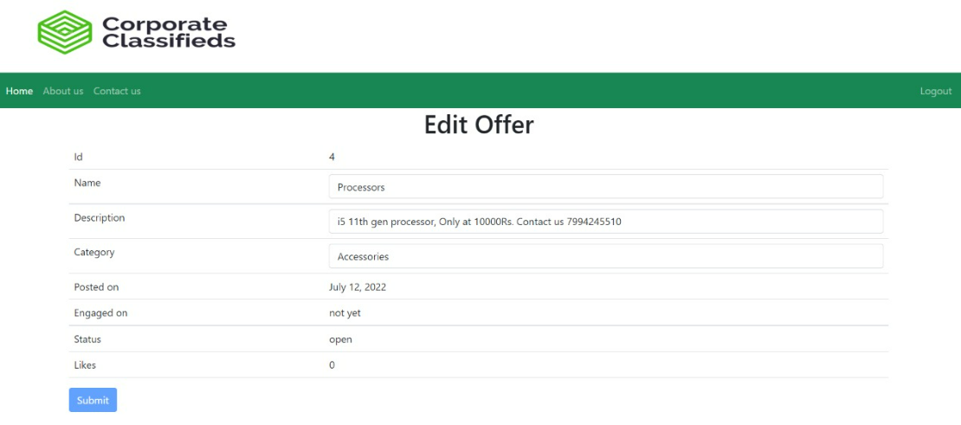
EDIT OFFER PAGE

Slide 51
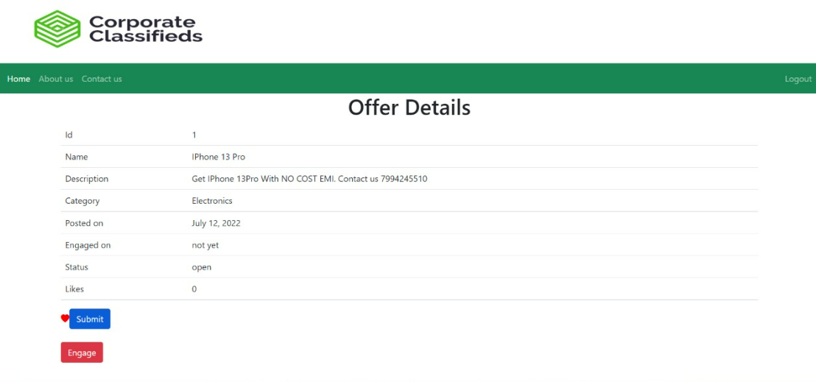
OFFER DETAILS PAGE

Slide 52
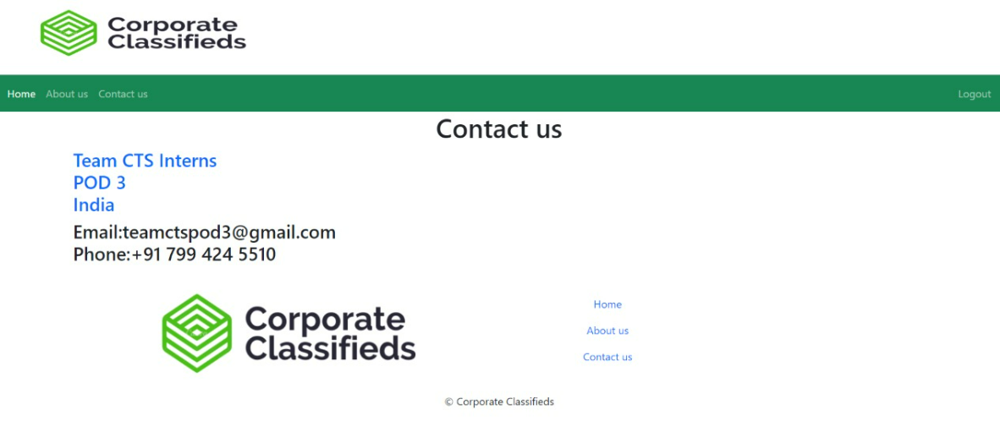
CONTACT US PAGE

Slide 53
DEPLOYMENT

Slide 54
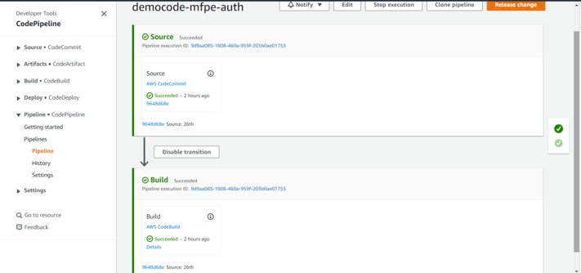
Authentication Service
CI/CD Pipeline for auth-service

Slide 55
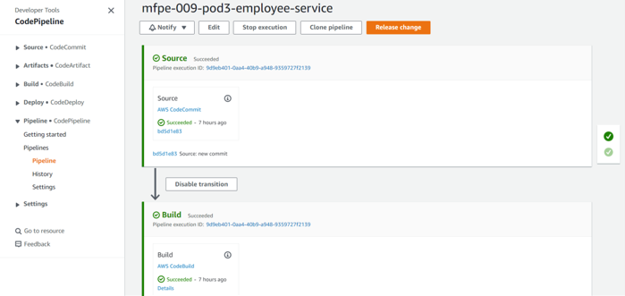
Employee Service
CI/CD Pipeline for employee service

Slide 56
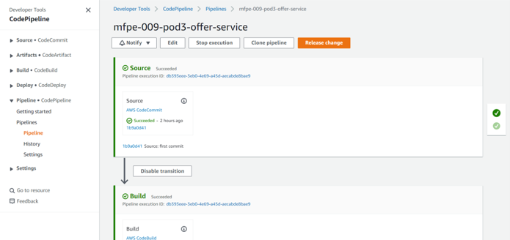
Offer Service
CI/CD Pipeline for offer service

Slide 57
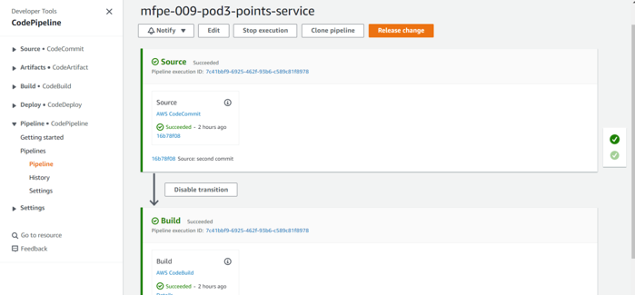
Points Service
CI/CD Pipeline for points service

Slide 58
Thank You

